Slide 1

BLOCKCHAIN TECHNOLOGY
Investigating the Security &Potential Vulnerabilities

Slide 2


Eva Islam
2020-1-60-273
Computer Science and Engineering
Saiful Islam
2020-1-60-184
Computer Science and Engineering
Nisu
2020-1-60-186
Computer Science and Engineering

Slide 3


Slide 4

51% Attacks:
Controls most of the nodes.
More than 51% of the mining power.
They can alter the system in a way that violates immutability.

Slide 5

Selfish mining:
Miners can earn money even if they have only 25% of the computational power.
Selfish miners keep the discovered blocks secret with the intention of eventually forking the chain.
Selfish miners continue to mine new blocks while keeping the blocks to themselves.

Slide 6
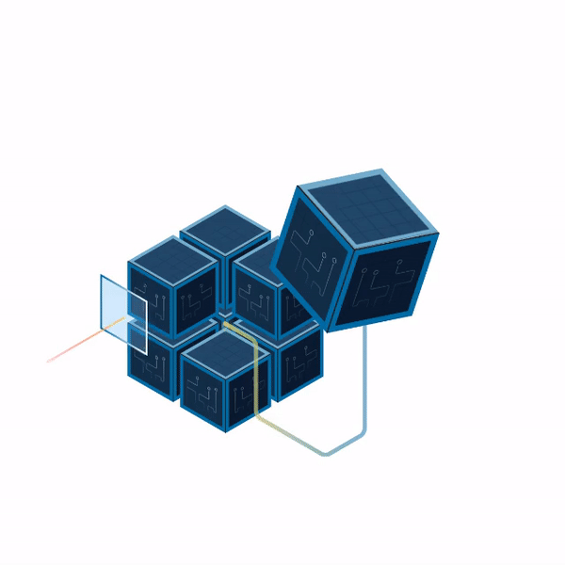
Smart contracts attacks – the DAO attack & hard fork:
The Ethereum community ultimately opted to hard fork the network.
A hard fork is a change to a blockchain network’s protocol that results in two distinct blockchains.

Slide 7
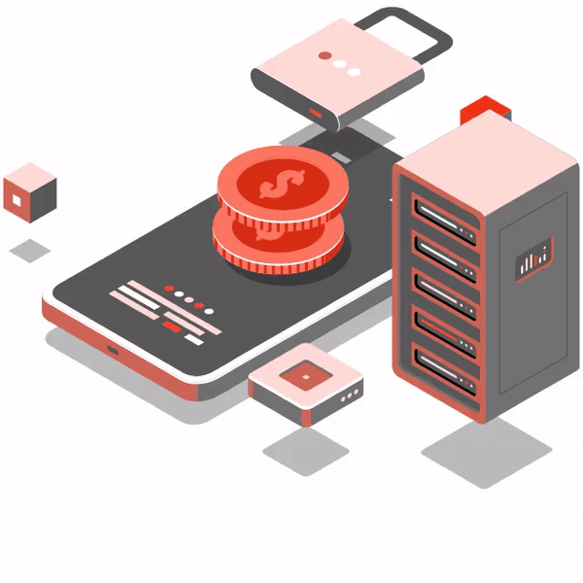
ICO scams:
An ICO is a technique of raising funds for blockchain firms by issuing and selling new tokens or coins to investors and contributors in exchange for current cryptocurrencies such as Bitcoin or Ethereum. While many reputable ICOs have assisted in the funding of potential initiatives, some have been fraudulent or frauds.
According to a 2017 report, frauds received $1.34 billion, accounting for 11% of total funding of $11.9 billion

Slide 8

Sybil Attack:
The attacker has control over a disproportionately large number of nodes in comparison to other honest network participants.
By controlling a significant number of the nodes, the attacker has the potential to damage the system's integrity, security, and consensus processes.

Slide 9


Slide 10

Security:
Proof of Identity:
Proof of identity consensus techniques have issues, such as excluding minorities or manipulating smaller blockchain network. Groups of thieves can more easily access a blockchain using a variety of devices, buying more votes for themselves.
Proof of Stake:
If a group of people buys more than half of a blockchain's assets, they take control of it.Both the proof of stake and the proof of identity approaches are vulnerable to a 51 percent attack.

Slide 11

Transparency:
Because it makes it possible for participants to know what each member is doing in real time, complete transparency is not preferred in a commercial setting. There are private blockchains that have limitations and can prevent members from seeing specific transactions.

Slide 12

Scalability:
Massive storage is needed, and the bigger the blockchain, the more processing power the nodes need to handle it all. Blockchain governance will be next to impossible, even if all digital, software, and hardware prerequisites are met.

Slide 13

Transaction speed:
Contrast the speed of Bitcoin transactions with that of organizations like Visa. Currently, Bitcoin can guarantee 4.6 transactions per second. Visa, on the other hand, regularly completes 1,736 transactions every second. Numerous businesses and organizations are speeding up blockchain transactions, but each of these strategies has disadvantages of its own.

Slide 14

Energy Consumption:
Proof of Work:
Proof of work mining requires a miner to solve a challenging mathematical problem, which uses a lot of computing resource. As the number of competing nodes on a blockchain increases, there is rivalry for more computational power, which consumes more energy. This extremely complex confirmation mechanism is incredibly wasteful because only one node may prevail in the race to confirm the subsequent block.

Slide 15


Slide 16
Cryptography:
Hash Function:
Blockchain technology uses hash functions to build a safe and impenetrable chain of blocks.
Digital Signatures:
Blockchain relies on digital signatures to authenticate transactions and thwart fraud. A mathematical system known as a digital signature can be used to confirm the legitimacy of digital messages or documents.
Zero Knowledge Proof:
Zero-knowledge proofs enable one person to demonstrate to another that they are aware of something without disclosing any more details.
Ring Signatures:
Ring signatures enable a group of individuals to sign a transaction jointly, but it is hard to identify which individual signed the transaction.
Mixer:
Services that combine the funds of many users also referred to as "mixers" or "tumblers" make it more challenging to trace the source and destination of funds. By making it more challenging to track the movement of money, this can be used to enhance the privacy of transactions.

Slide 17

Consensus Mechanisms:
Consensus processes are used to make sure that everyone in the blockchain network agrees on the state of the network. Consensus mechanisms, a class of algorithms, allow nodes to concur on the validity of data and the chronological order of transactions. Blockchain employs a number of consensus techniques, including delegated proof of stake (DPoS), proof of stake, and proof of work (PoW).

Slide 18

Data Structures:
Linked lists are the most common sort of data structure used in blockchain. They are a rapid and efficient method for storing data and chaining blocks together. Other forms of data structures that are occasionally used in blockchain technology include trees, graphs, and Merkle trees.

Slide 19

METHEDOLOGY:
Literature Survey
Threat Analysis
Vulnerability
Examination
Attack Simulation
Risk Assessment
Mitigation Strategy
Evaluation

Slide 20


